Slide 1
    UX Research
Patricia Pérez
eCommerce | 2022

Slide 2
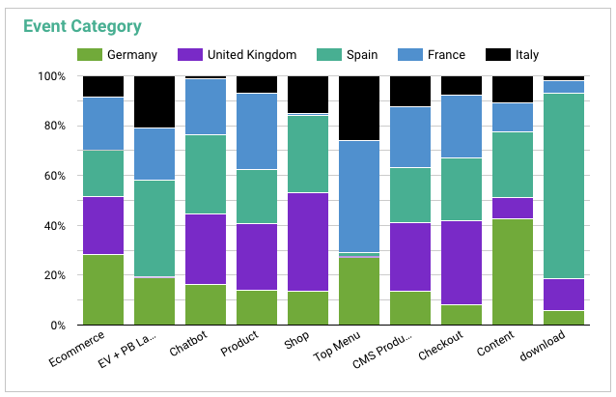

1
Germany
Insights
They focus on content
They also look at the info navigating through the menu
DE
January 1st to May 17th

Slide 3
1
Germany
Actions
We are also tracking the content to understand in which pages the users are clicking more
  Page views
  Time on page
  Buttons
We are analyzing the user flow and exit pages to understand why they keep on the research stage and what is stopping them to jump to the shop
Reminders: you have products on your cart
Cart abandoned email
Products you have seen email: “are you still interested?”

Slide 4
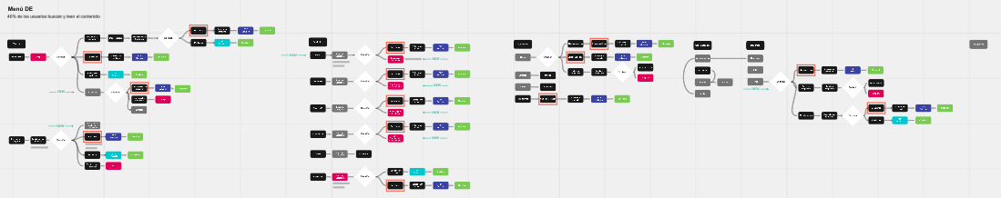
1
Germany
Ideal User Flow

Slide 5

2
United Kingdom
Insights
British avoid navigation thought content pages and website menu
As they are well informed about this kind of products, they are more willing to buy.
UK
January 1st to May 17th

Slide 6
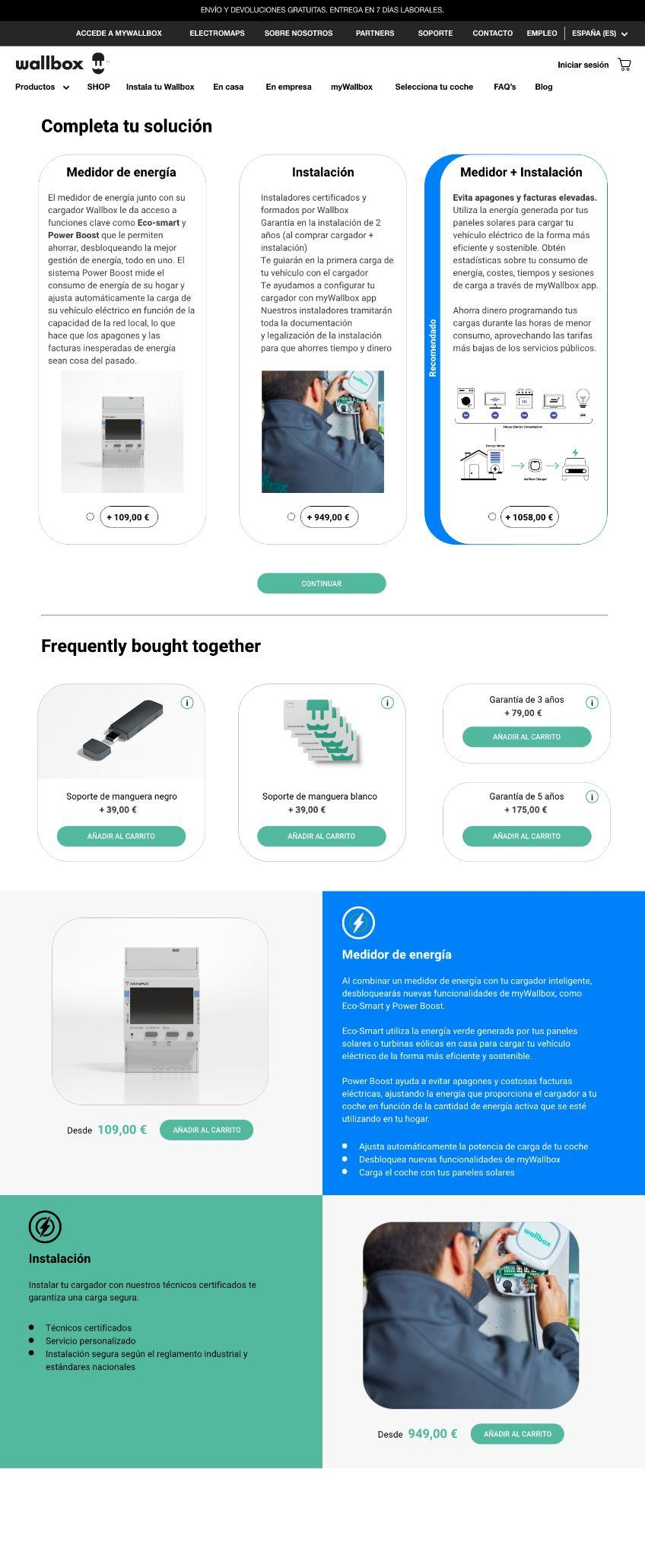
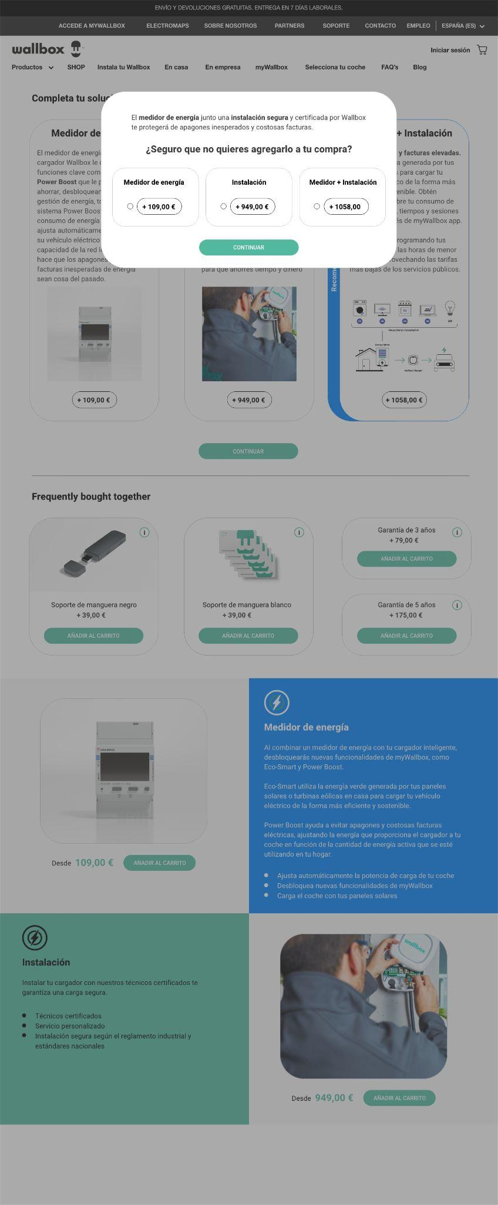
2
United Kingdom
Actions
Focus on online campaigns that drives the user to the shop
Focus on showing cross and up selling products as we will do on the new pdp

Slide 7
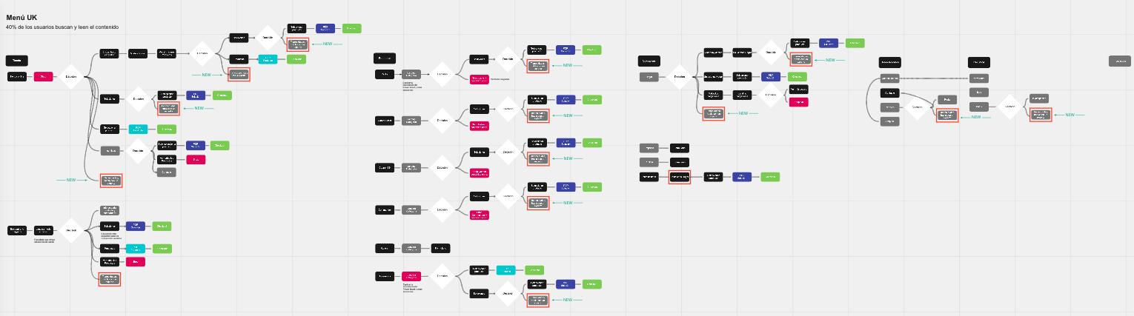
2
United Kingdom
Ideal User Flow

Slide 8
3
Spain
Insights
Spanish people tends to get deep into details consulting the chatbot, downloading information or looking for content. They need to have all the info before going to the checkout.
They navigate through content pages and not through the menu
Next steps will be to obtain information about what spanish users are asking for in order to show all the info they need. (pre-sales, sales and support team)
ES
January 1st to May 17th

Slide 9
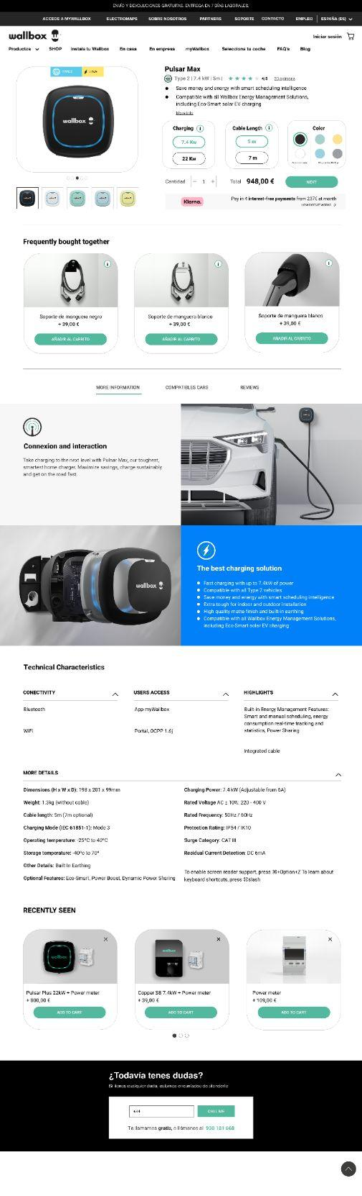
3
Spain
Actions
Because of this we have created a new PDP and Shop showing some extra information (using pyramidal structure) to avoid a high bounce rate, increase confidence and guide the user to the checkout process in a smooth way
We also should create some content for this kind of user

Slide 10
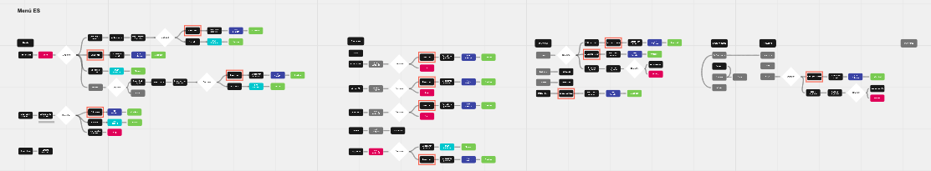
3
Spain
Ideal User Flow

Slide 11

4
France
Insights
Frenchs consult the website navigation and product pages
They feel more comfortable contacting Wallbox before proceeding with their shopping experience throughout the website.
FR
January 1st to May 17th

Slide 12
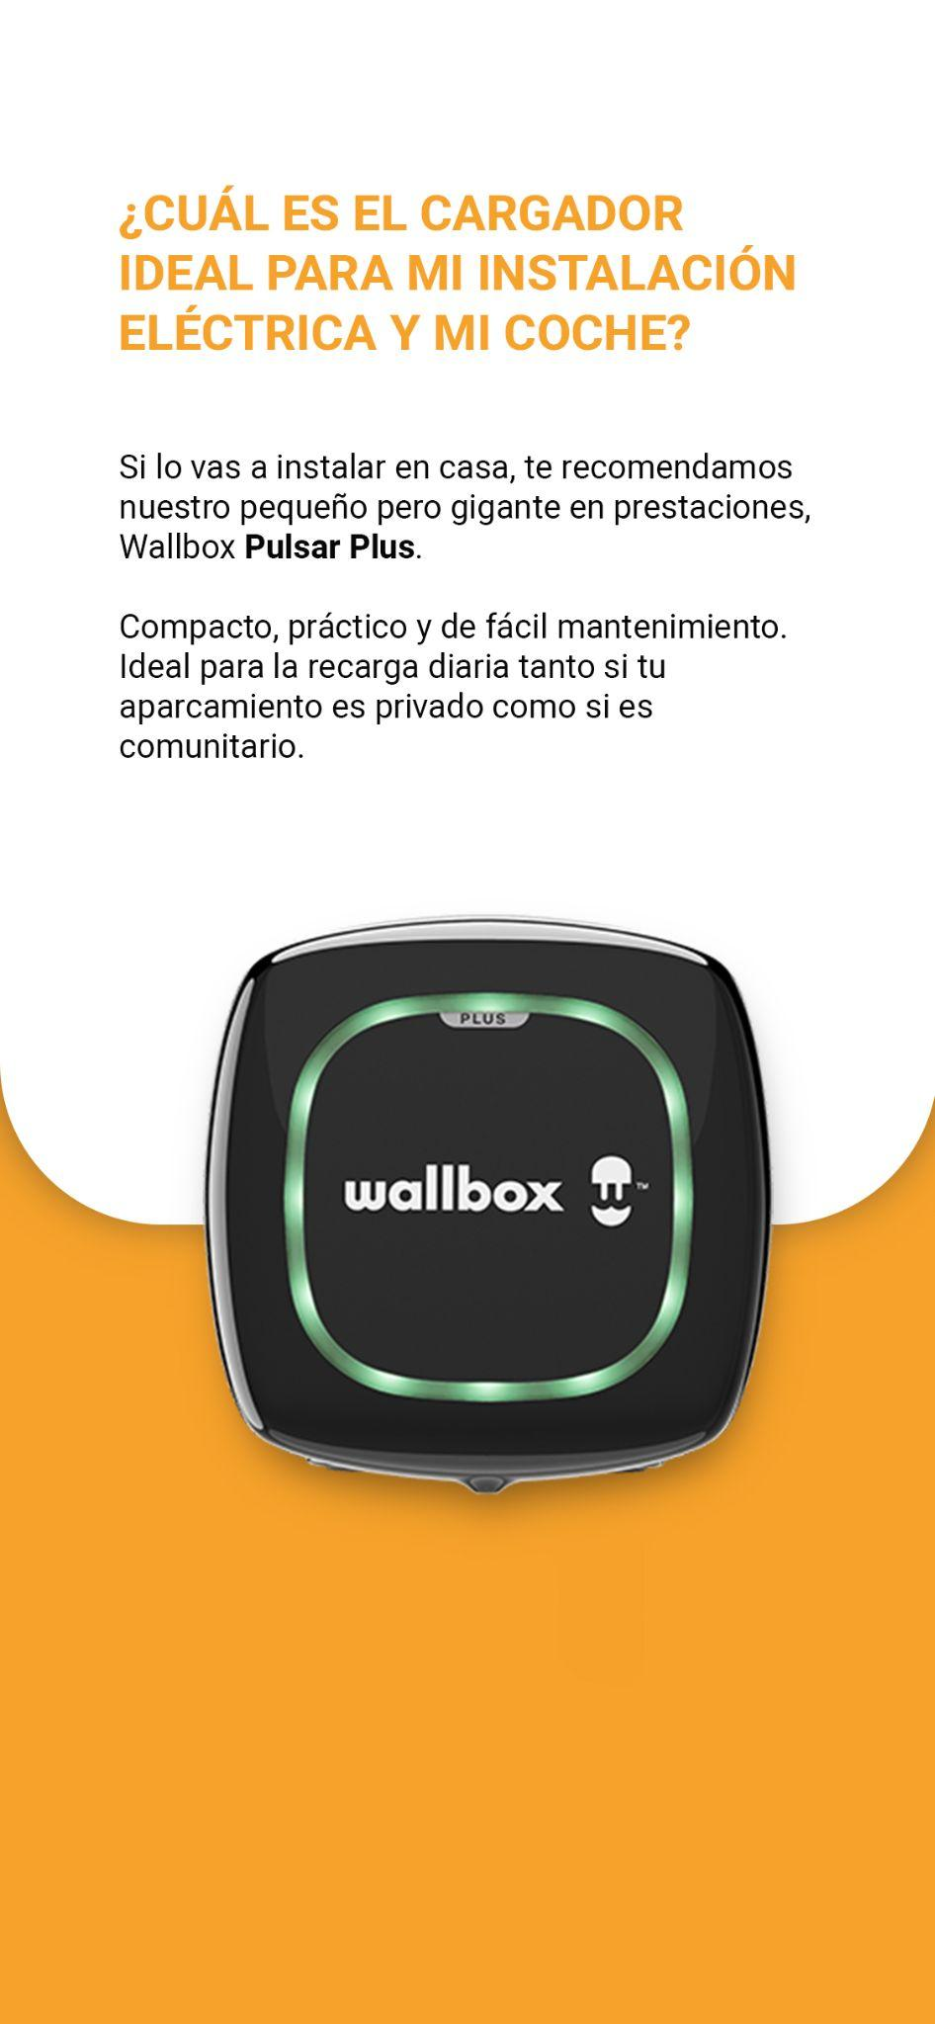
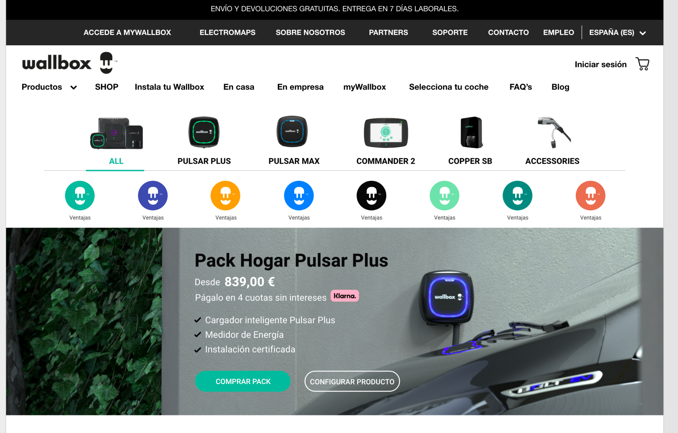
4
France
Actions
Presence of the chat on the whole website
Educational content like the stories

Slide 13
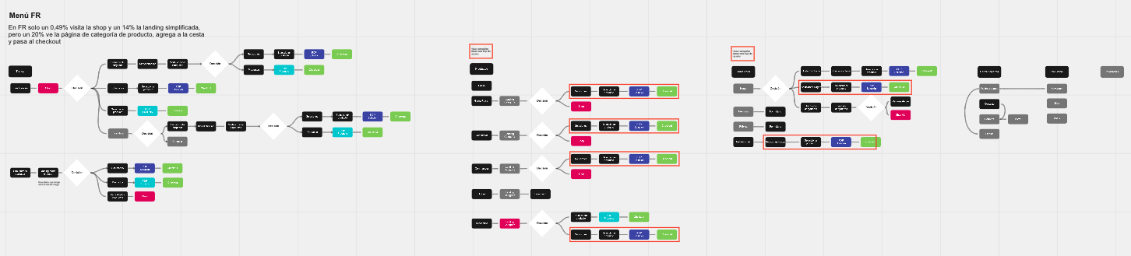
4
France
Ideal User Flow

Slide 14

5
Italy
Insights
They barely interact with the chatbot
They don’t dowload valuable content.
They use the top menu
IT
January 1st to May 17th

Slide 15
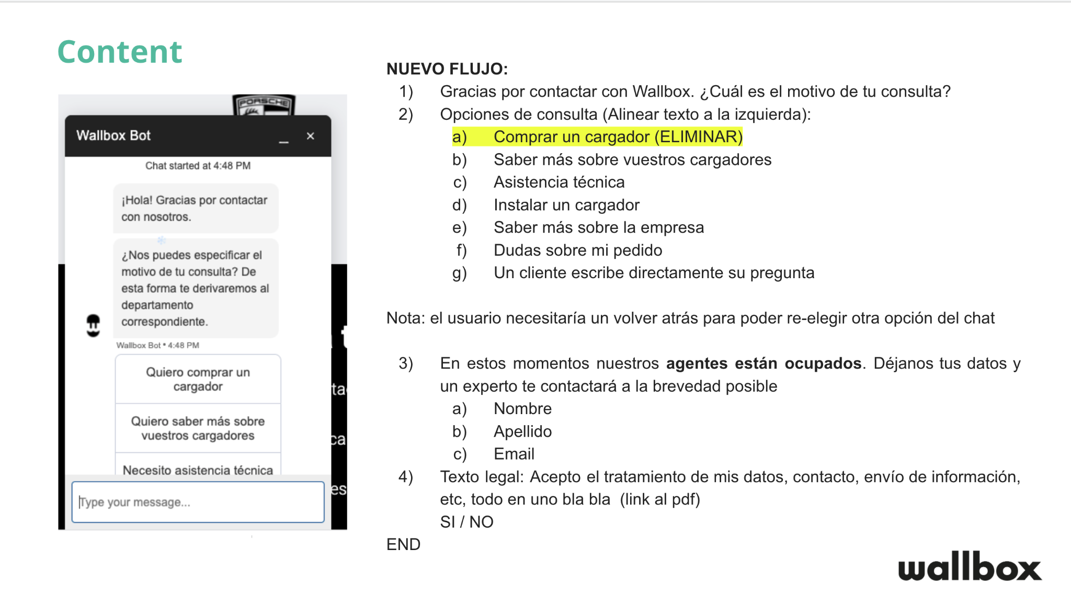
5
Italy
Actions
We could conclude that they are lost so:
We have to make sure the chatbot works on Italian too: chatbot project
Do some AB test on the chat
Measure other points of contact like calls or forms
Focus on information architecture

Slide 16
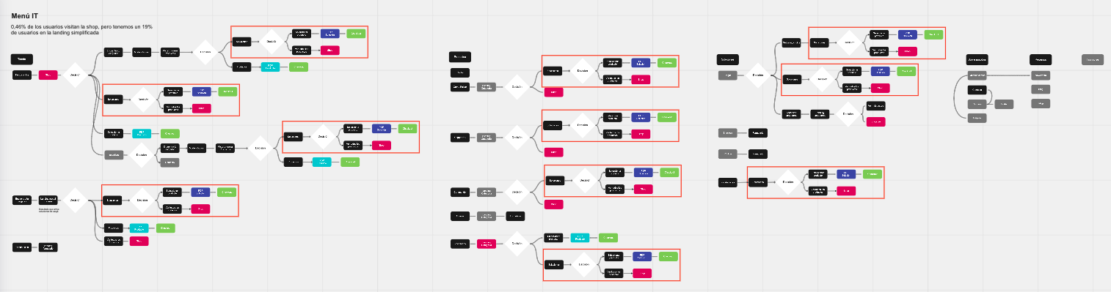
5
Italy
Ideal User Flow

